Slide 1
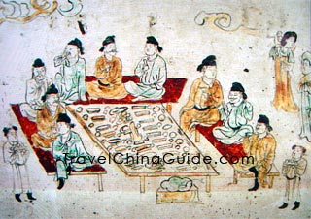
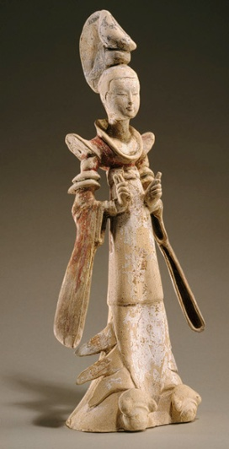
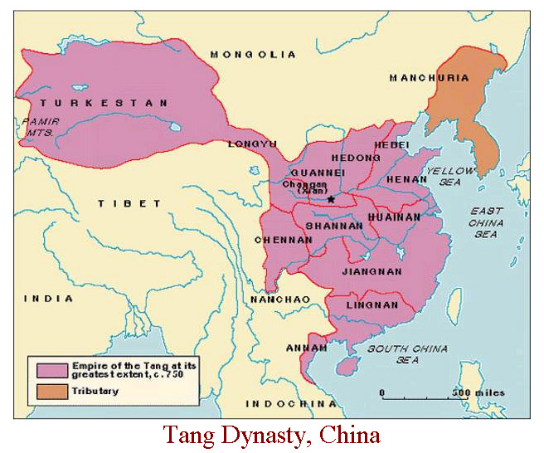
Two Golden Ages of China: Section 1
Tang Dynasty, 618 A.D.
Restored Chinese glory
Vietnam, Tibet, Korea became tributary states.
tributary states – stayed self governing, acknowledge Chinese supremacy, send tribute (money, goods)to emperor

Slide 2
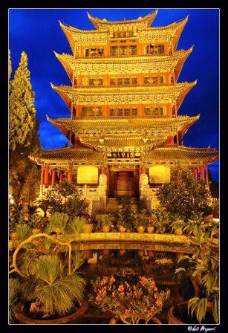
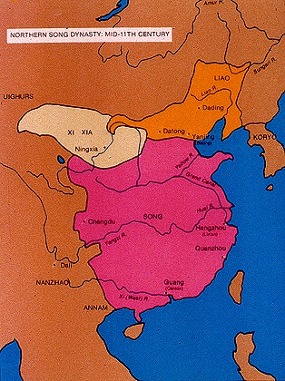
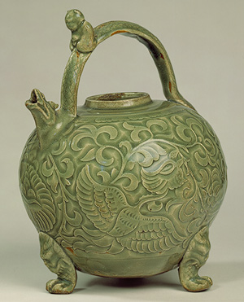
The Song Dynasty - 960 – late 1200s A.D.
Great achievements and culture
Improved farming methods = Surplus food
Foreign trade flourished – India, Persia, Arabia, as far away as E. Africa

Slide 3
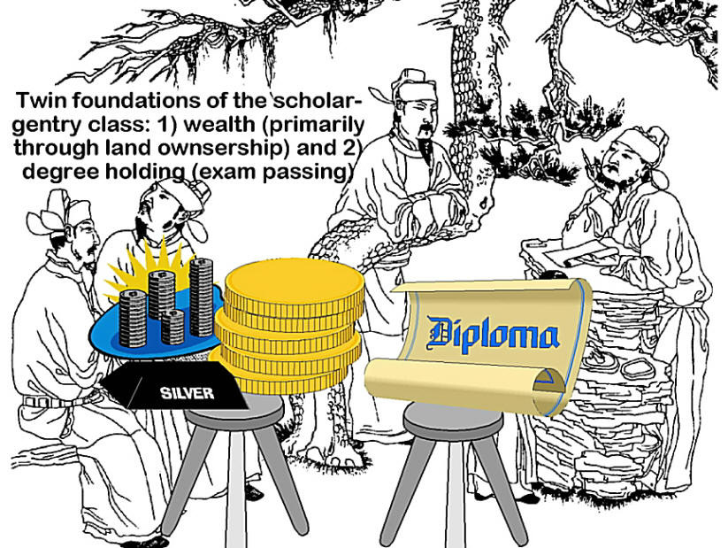
China’s Ordered Society
Scholar-official class = top level of society
Came from Gentry – wealthy landowning class -
had to pass difficult civil service exams
Gentry Value Education

Slide 4
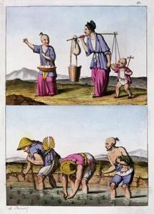
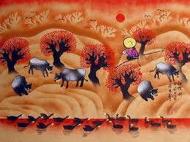
Peasants Work the Land
China’s Ordered Society
Most Chinese were peasants
Lived in small self sufficient villages
Could move up in society through education and government service

Slide 5
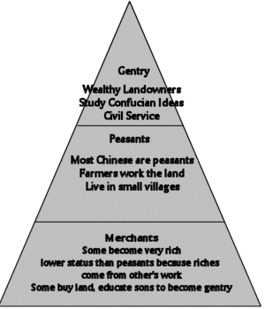
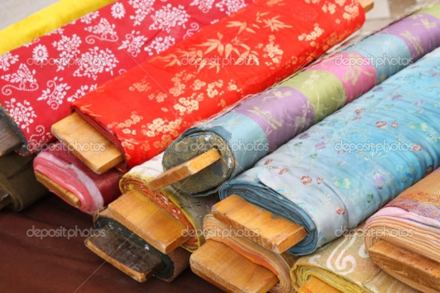
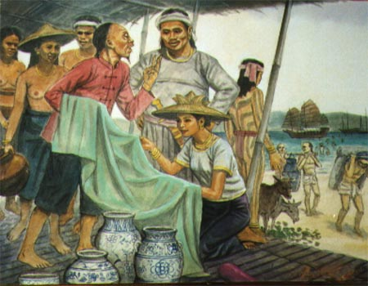
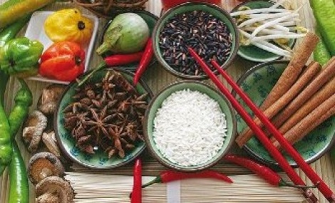
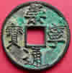
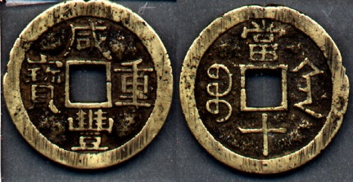
Merchants have lowest status
China’s Ordered Society
merchants became wealthy
Lower status because riches came from labor of others –against Confucian tradition

Slide 6
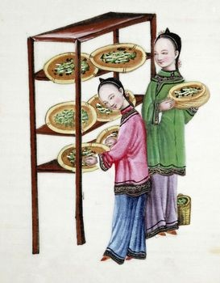
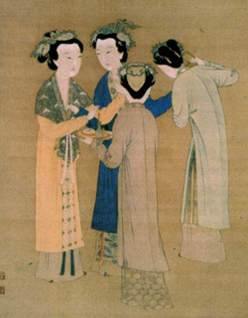
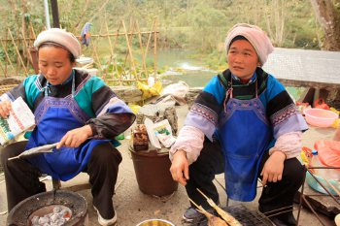
The Status
of Women
Women in Tang & Song Dynasty – were
subordinate
Managed household
Could never remarry

Slide 7
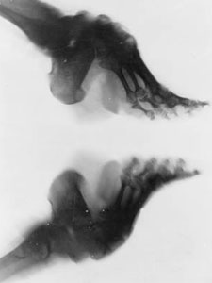
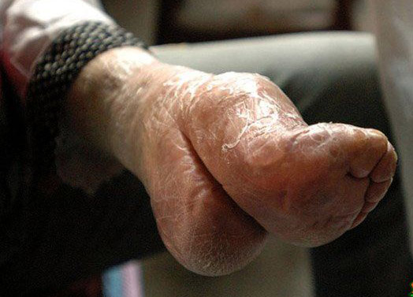
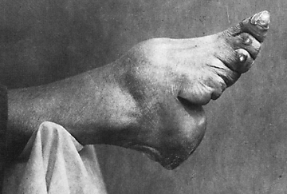
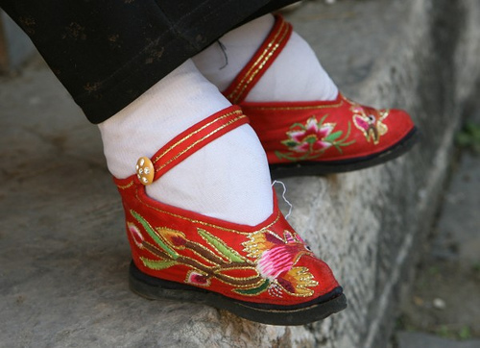
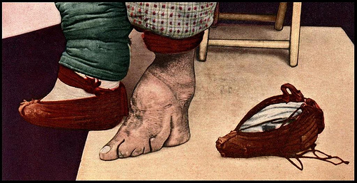
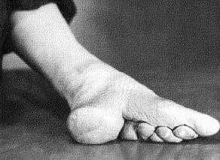
Foot Binding
Began in royal court
Spread to lower classes
Feet – bound w/long strips of cloth
Produced Lilly-shaped foot – half the size of normal foot
VERY PAINFUL!!! (Had to break foot to start process – started as a young girl)
became easily infected

Slide 8
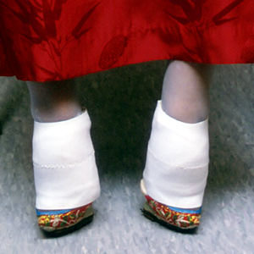
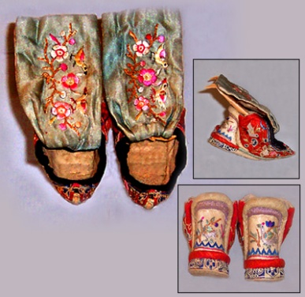
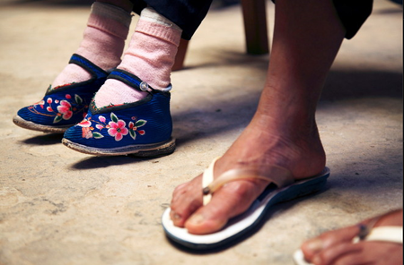
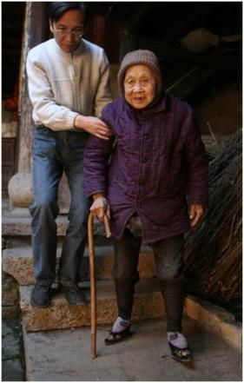
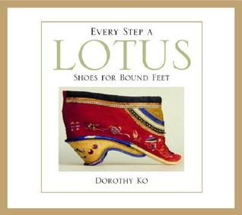
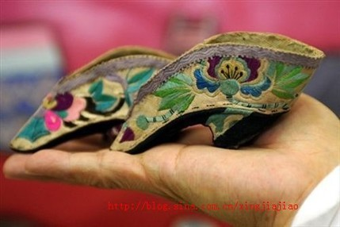
Foot Binding
Parents feared they could not find husband for daughter w/ “big feet”
Farm girls could not do this because you could NOT WALK without help!
Women were to stay inside home – oriental seclusion
Ended after WWII

Slide 9
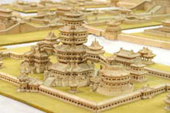
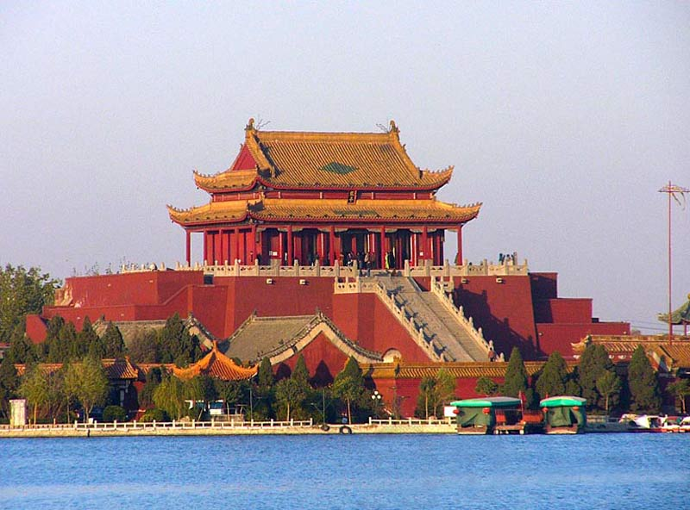
Chinese Architecture
<<Tang Dynasty Palace
Song >> Dynasty Palace

Slide 10
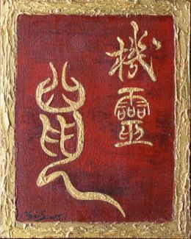
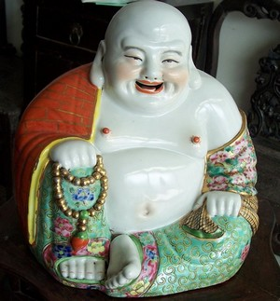
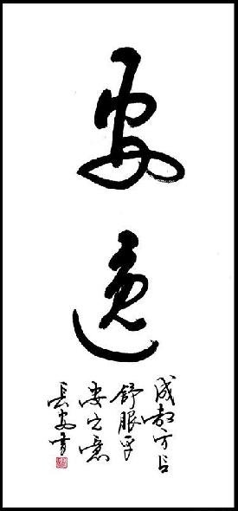
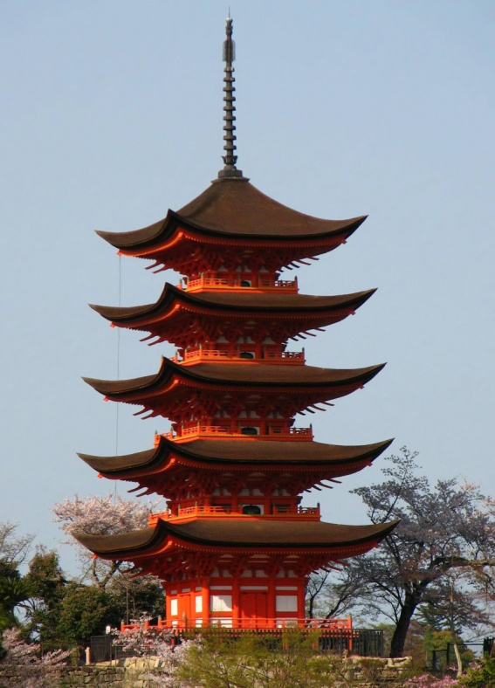
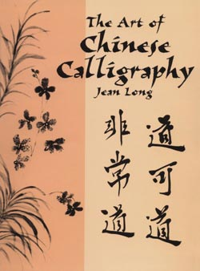
Chinese Architecture, Porcelain, & Calligraphy
PAGODA
Multistoried Buddhist Temple
Porcelain Chinese Buddha. Known as the Laughing Buddha
The Chinese worshipped Buddha as a god. They did not recognize him as an Indian Holy Man.

Slide 11
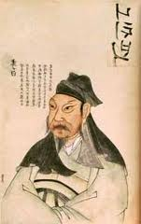
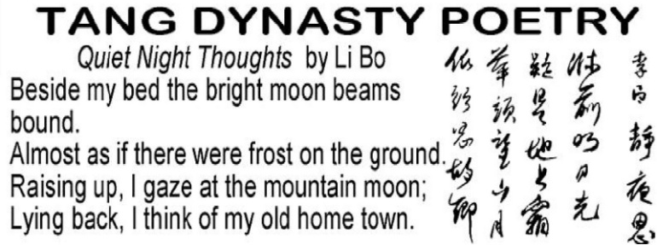
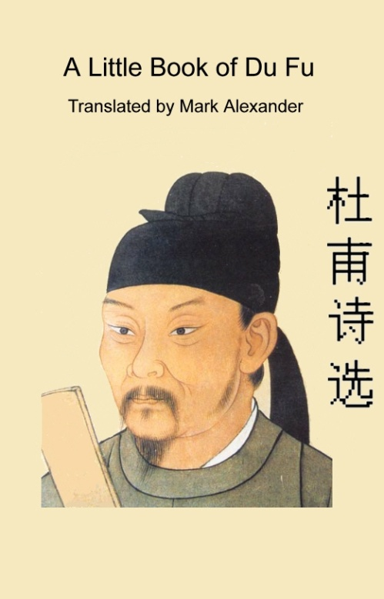
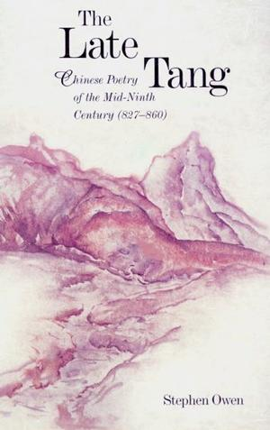
Chinese Poetry
Tang Poet Li Bo
Wrote 2,000 poems
Celebrating harmony with nature
Lamenting passage of time
Tang poet Du Fu
Described horrors of war
Condemned lavishness of court

